Slide 1

AI Smart Study Planner
Genetic Algorithm + Constraint Satisfaction
Group Memebers
Abdullah Shah Alam (IU04-0123-0462). Waqas Ahmed (IU04-0123-0691). Suhana Ali (Iu04-0322-0580).
Supervisor · Date
Sir Mubasshir Ahmed · 29-August-2026

Slide 2



Problem & Motivation
Manual study schedule planning forces students to juggle multiple competing requirements simultaneously — a task prone to error, conflict, and inefficiency.
Time & Effort
Conflicts & Capacity
Time-consuming manual planning; difficulty balancing multiple subjects simultaneously
Preventing scheduling conflicts; respecting limited daily study capacity
Priority & Difficulty
Hour Balance
Managing different priority and difficulty levels; respecting preferred study-time requirements
Maintaining fair allocation across subjects without over- or under-scheduling any course
Session Management
Core Insight: A study timetable must satisfy multiple requirements simultaneously — making automated optimization highly valuable.
Ensuring adequate breaks; avoiding excessive consecutive sessions; maintaining subject-hour balance

Slide 3
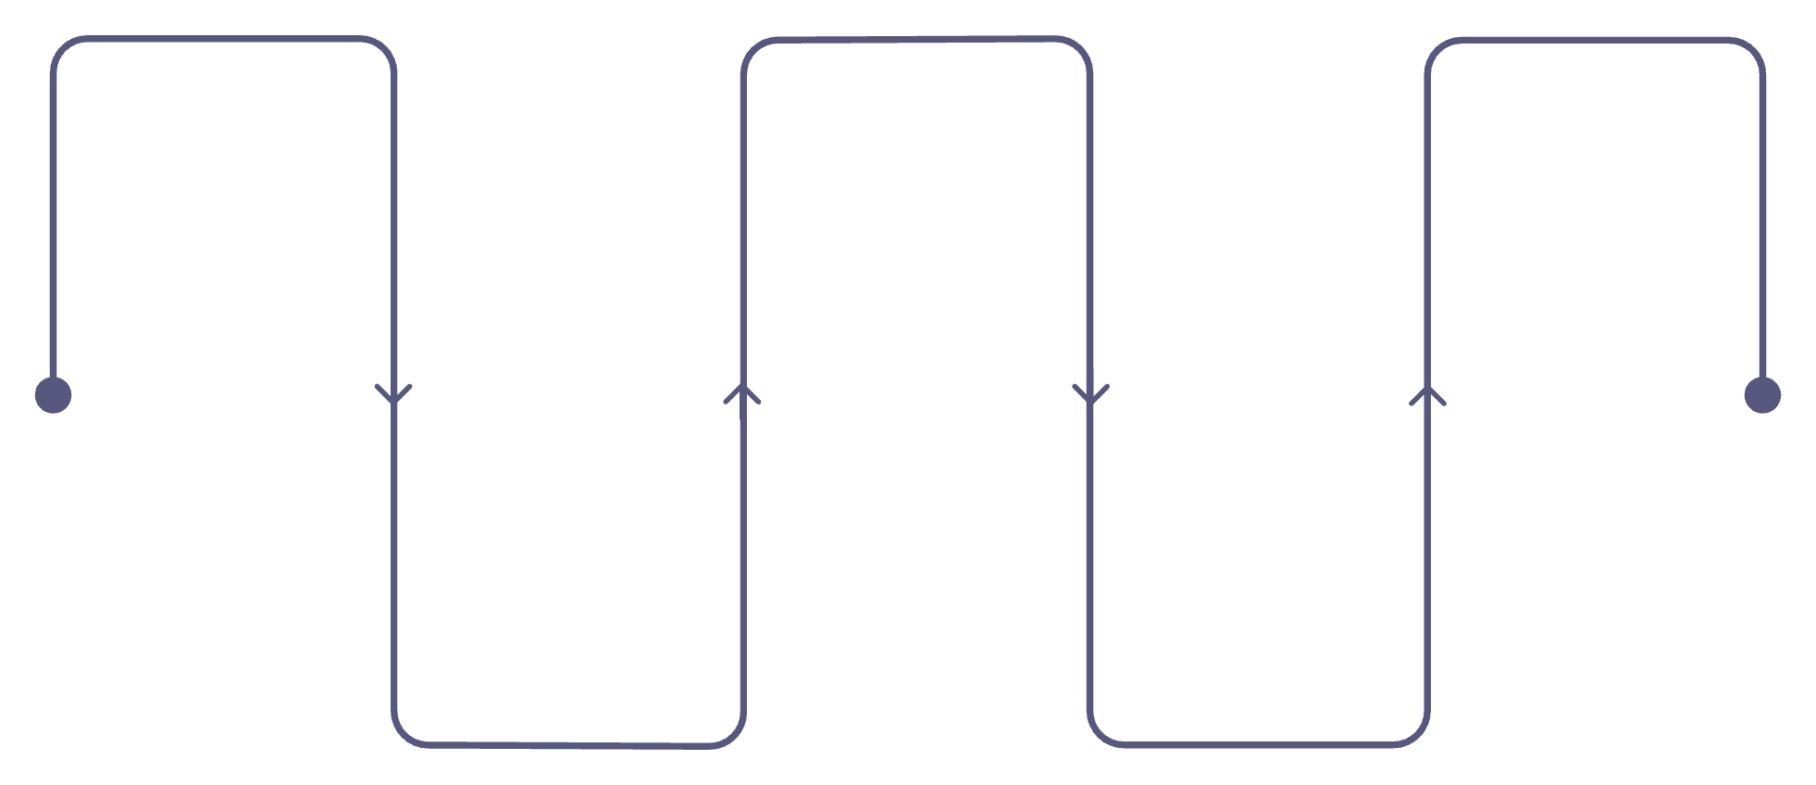
Project Objectives & Proposed Solution
Objectives
Proposed Solution Pipeline
Automate timetable generation
User Input
Genetic Algorithm
Optimized Timetable
Optimize study time allocation
Provide goals, priorities, constraints
Optimize allocation and sequencing
Final schedule respecting preferences
Consider priority and difficulty levels
Respect preferred study periods
Candidate Schedule
CSP Validation
Maintain breaks between sessions
Generate initial session proposals
Check conflicts and constraint rules
Avoid scheduling conflicts
GA
CSP
Validate all constraints
Optimization
Validation
Report schedule overflow

Slide 4
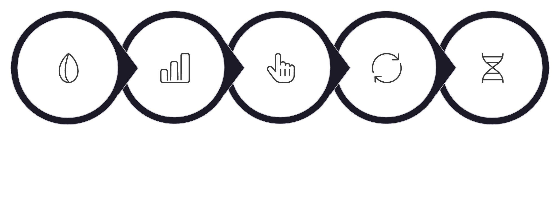

How the Genetic Algorithm Works
Initial Population
Fitness Evaluation
Selection
Crossover
Mutation
Initial Population
Fitness Evaluation
Selection & Crossover
Mutation
Multiple candidate schedules are generated as starting points
Each candidate is scored against all scheduling requirements
Better candidates are chosen and combined to create new schedules
Small changes introduce variation and prevent premature convergence
Best Solution
The strongest candidate across all generations is selected
Why Genetic Algorithm? Timetable optimization involves many interacting scheduling choices. GA explores multiple candidate schedules and improves them iteratively across generations.

Slide 5
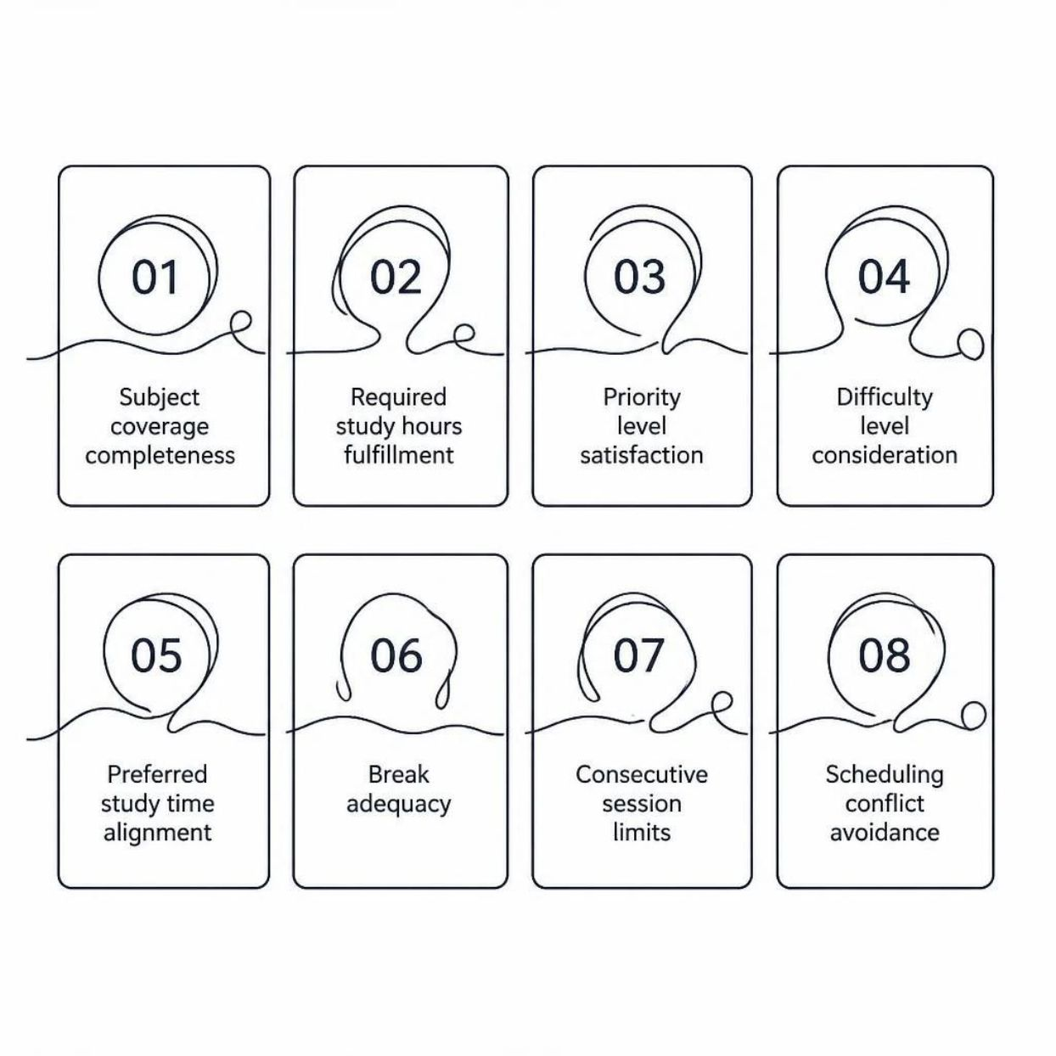
Fitness Evaluation
Candidate schedules are scored based on how completely they satisfy all scheduling requirements. Higher fitness signals a better, more constraint-compliant schedule.
Evaluation Flow
01
Candidate Schedules
Multiple population members submitted for scoring
02
Fitness Evaluation
Each schedule measured against all eight requirement dimensions
03
Compare & Rank
Candidates ordered by their aggregate fitness score
04
Better Candidates Selected
Top performers advance to reproduction and next generation

Slide 6

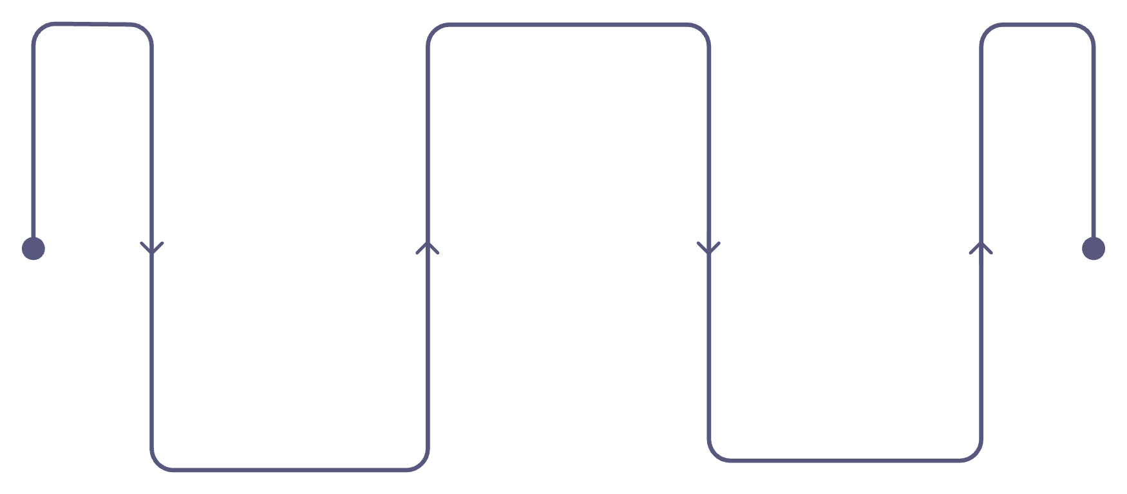
Constraint Satisfaction (CSP)
The Genetic Algorithm optimizes candidate schedules; Constraint Satisfaction validates whether the generated schedule satisfies every required constraint before final output.
Constraints Validated
Daily Study Window
✓ No missing subjects
08:00 – 24:00
✓ No overlapping time slots
✓ Adequate breaks included
CSP Checking
Validate all required constraints
✓ No excessive consecutive study sessions
✓ Subject hours not exceeded
Validated Schedule
GA Optimization
Optimize candidate schedules
Final schedule ready for output
✓ Daily time capacity respected

Slide 7





System Architecture & Technology Stack
Application Architecture
Technology Stack
Tkinter GUI
Python
Tkinter
Desktop interface for all user interactions and results display
Core application language
Desktop GUI framework
Input / Configuration Layer
NumPy
Matplotlib
Subject management, GA parameters, and study preferences
Numerical & computational support
Graphs & visualizations
Genetic Algorithm Engine + Fitness Evaluation
Standard Library
Core optimization: population management, crossover, mutation
Supporting functionality
CSP Validator → Results & Visualizations
No Database · No API · No Cloud Backend · No External Credentials
Constraint checking, timetable output, and Matplotlib graphs

Slide 8
Application Workflow & Key Features
9-Step User Workflow
Key Application Features
01
Subject Management
GA Configuration
Add subjects
Add, configure, and manage all study subjects
Tune population size, generations, and mutation rate
02
Enter required study hours
Timetable Visualization
Fitness Progress Graph
03
Optimized daily schedule rendered graphically
Matplotlib chart showing improvement across generations
Set priority level
04
Set difficulty level
CSP Analysis Report
Overflow Detection
Detailed constraint satisfaction validation output
Subject-hour summary and schedule overflow reporting
05
Select preferred study time
06
Configure GA parameters
07
Generate optimized schedule
08
Validate constraints
09
Analyze results

Slide 9
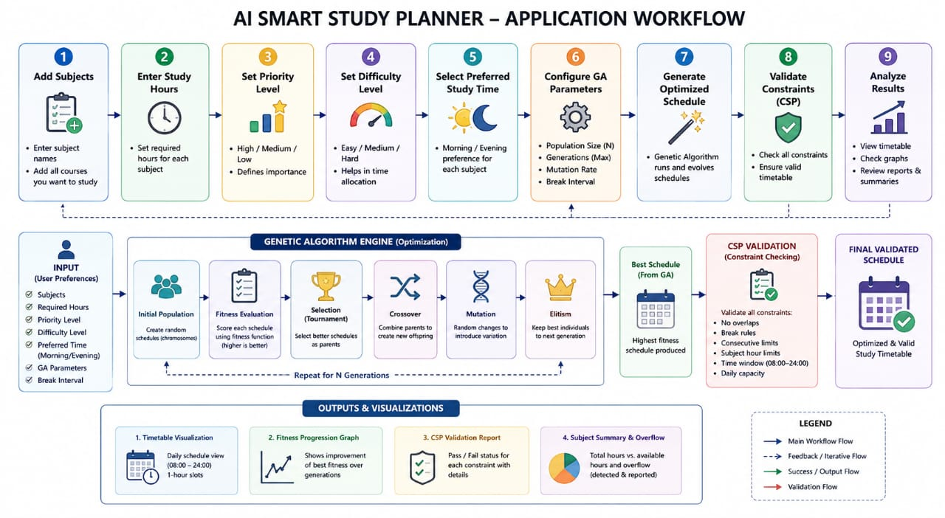

Slide 10




Outputs, Challenges & Future Enhancements
System Outputs
Challenges & Approach
Optimized Daily Timetable
Challenge | Approach
Multiple scheduling requirements | GA-based optimization
Daily 08:00–24:00 capacity | Overflow detection & reporting
Consecutive session limits | CSP validation
Break management | Constraint checking
Schedule validation | CSP applied post-optimization
Complete validated schedule for the study window 08:00–24:00
Fitness Progression Graph
Visual GA improvement across generations
CSP Validation Results
Detailed constraint satisfaction analysis report
Subject-Hour Summary & Overflow Info
Distribution analysis and overflow detection output
FUTURE ENHANCEMENTS — NOT CURRENT FEATURES
Multi-day scheduling
User profiles & persistent storage
Calendar integration & PDF / Excel export
Notifications, reminders & advanced constraint repair
Comprehensive testing suite

Slide 11
Conclusion
AI Smart Study Planner combines Genetic Algorithm optimization, Constraint Satisfaction validation, and visualization to automatically generate and validate optimized daily study schedules.
Genetic Algorithm
Constraint Satisfaction
Optimization & Search
Validation & Checking
Visualization
= Optimized & Validated Study Schedule
Analysis & Reporting
Automated · Constraint-Compliant · Transparent
THANK YOU
QUESTIONS?

